Slide 1
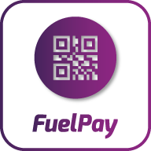
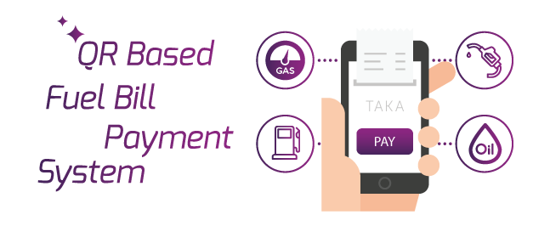

Slide 2


OUR
INSPIRATION

Slide 3
How to find stations?
Stations are open or close!
How much fuel rate going on?
Consume huge time during money exchange!
WHY
FUELPAY?

Slide 4






Fuel Rate
Fuel Calculator
Map Finder
OUR
FEATURES
Station Traffic
QR payment
Driving Mood

Slide 5


Android
PHP
Android platform, Java and XML language
PHP, Codeigniter Platform, HTML,
CSS, MySQL Database
OUR
TECHNOLOGY

Slide 6

API
Server
(PHP, Codeigniter Platform, HTML,
CSS, MySQL Database)
MySql Database
Application User
Admin User
(Station setup, Fuel Rate setup, User setup, Add money setup)
TECHNOLOGY
DIAGRAM

Slide 7
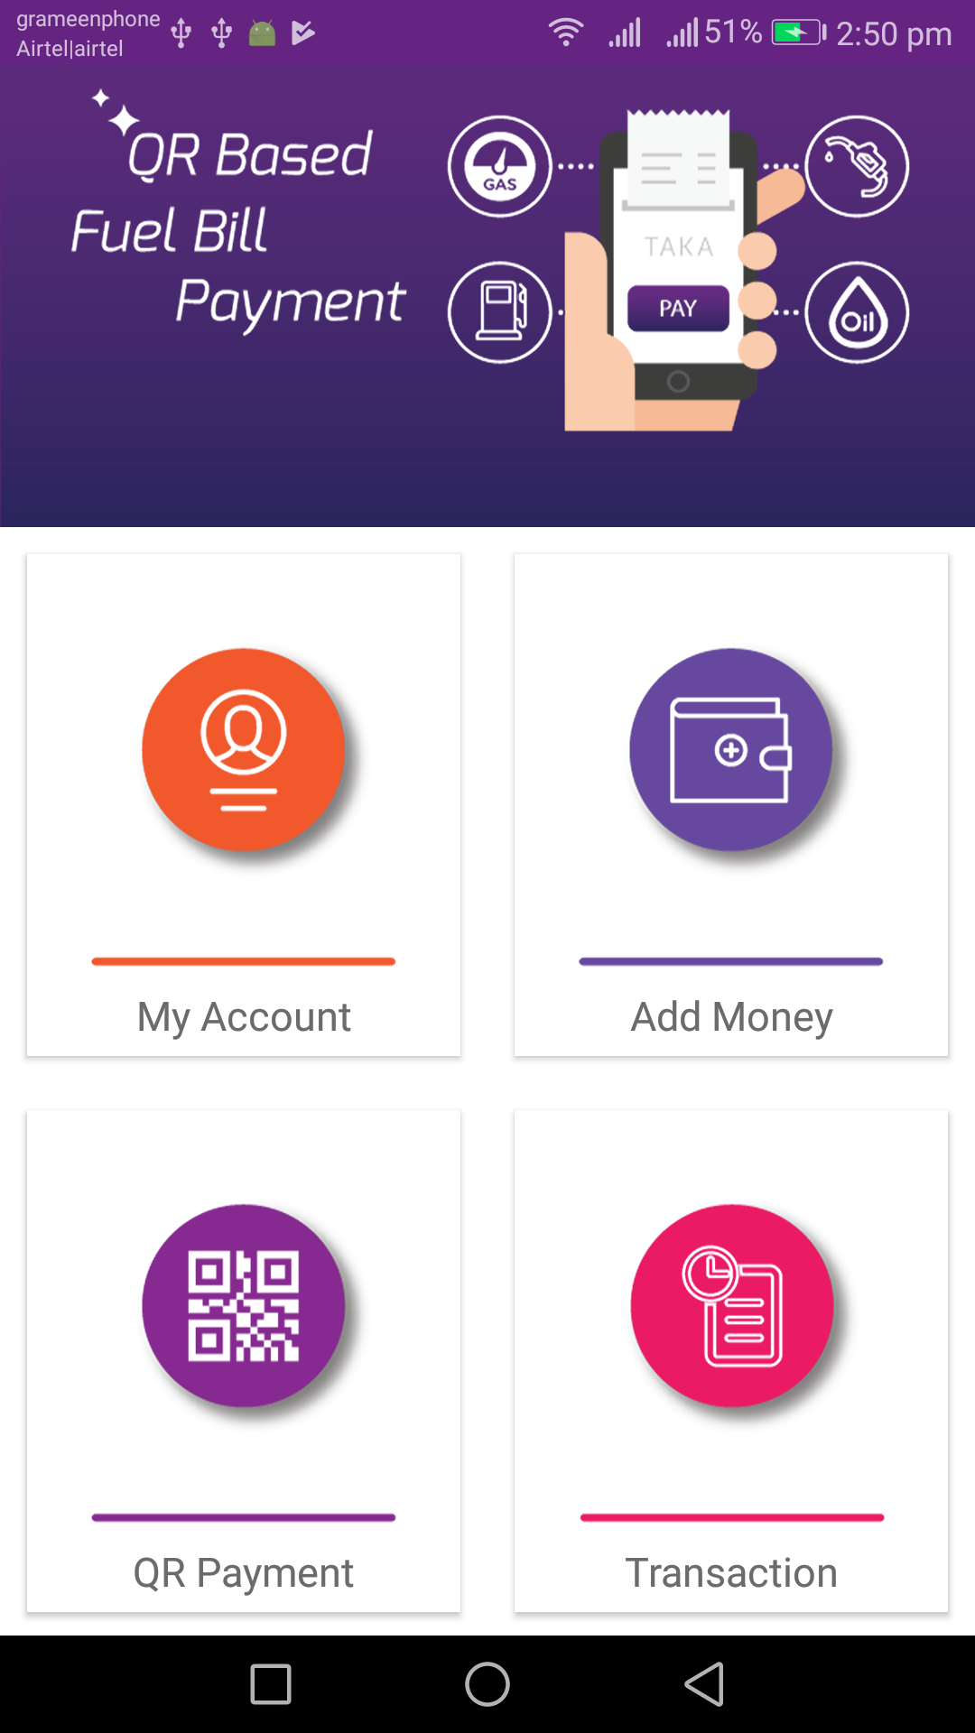
ANDROID
APPLICATION

Slide 8
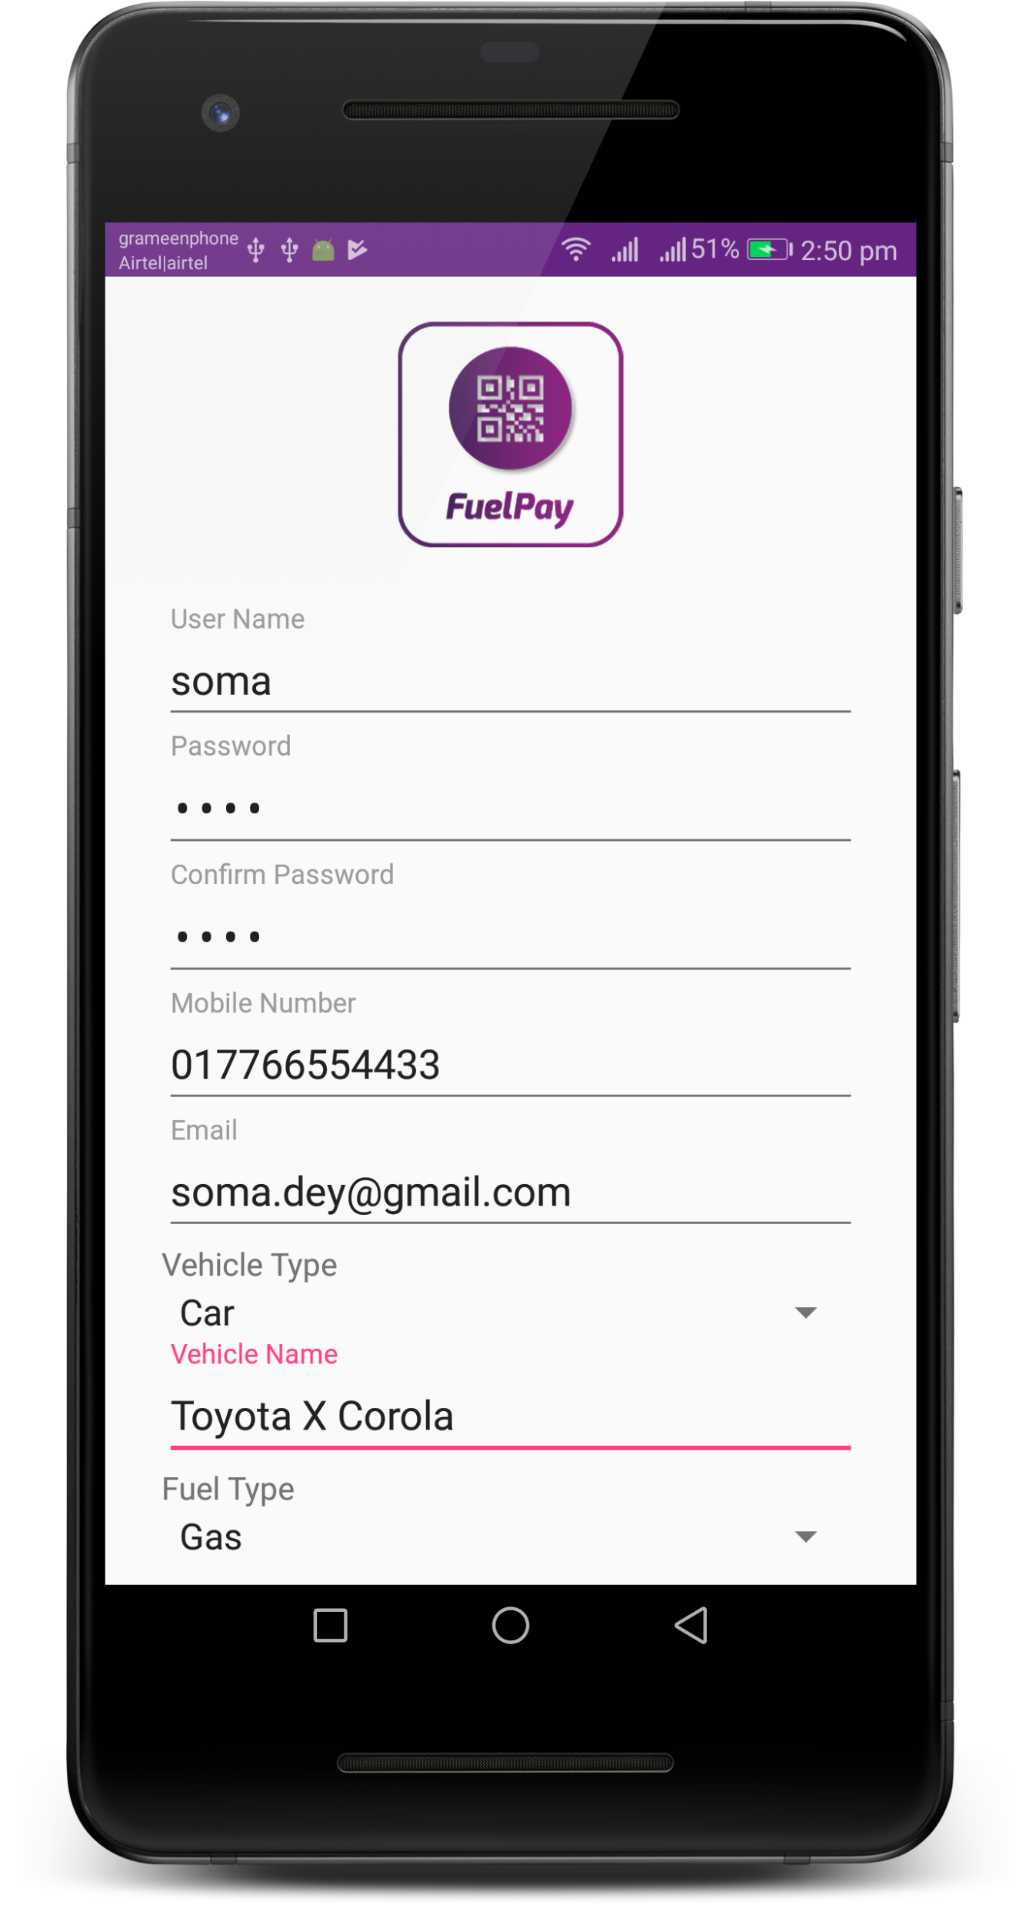
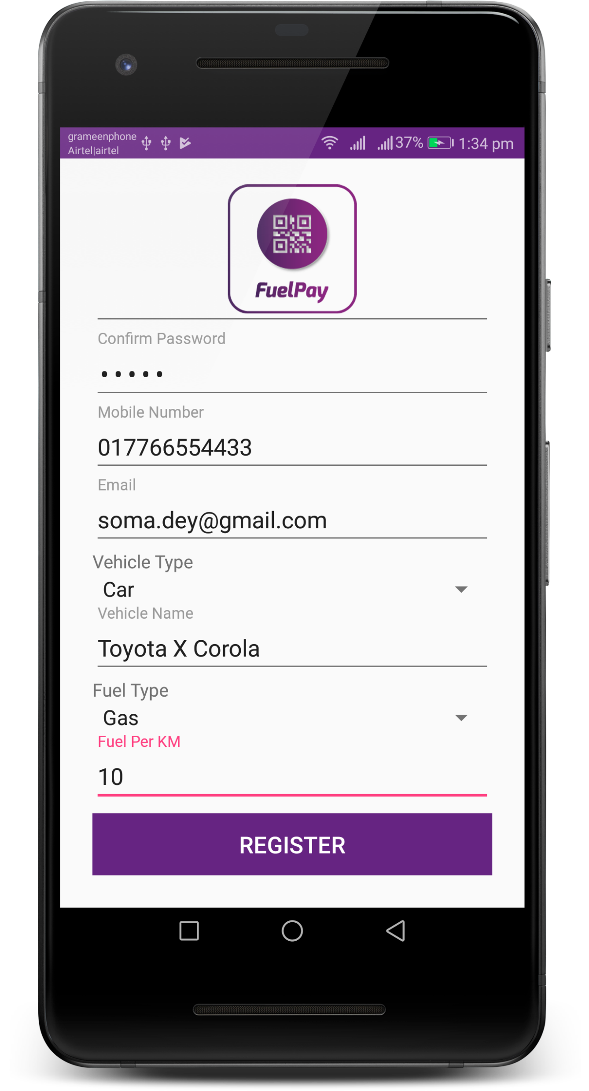
USER
REGISTRATION

Slide 9
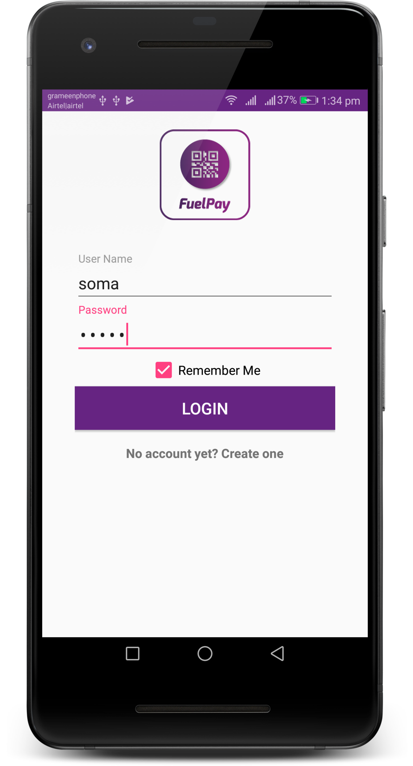
USER
LOGIN

Slide 10
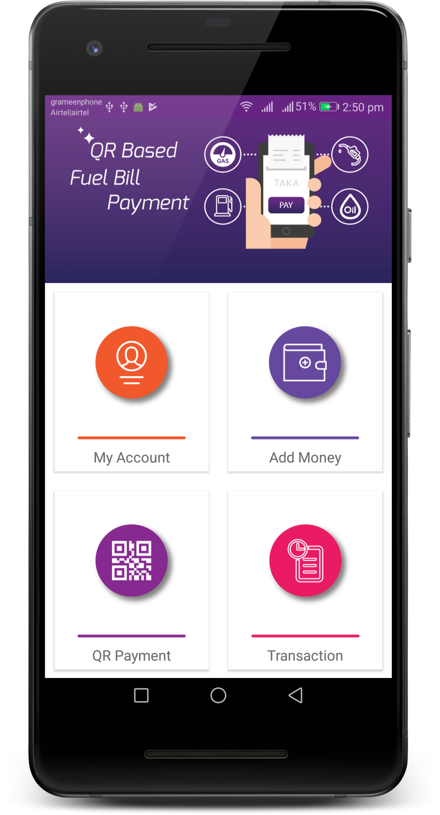
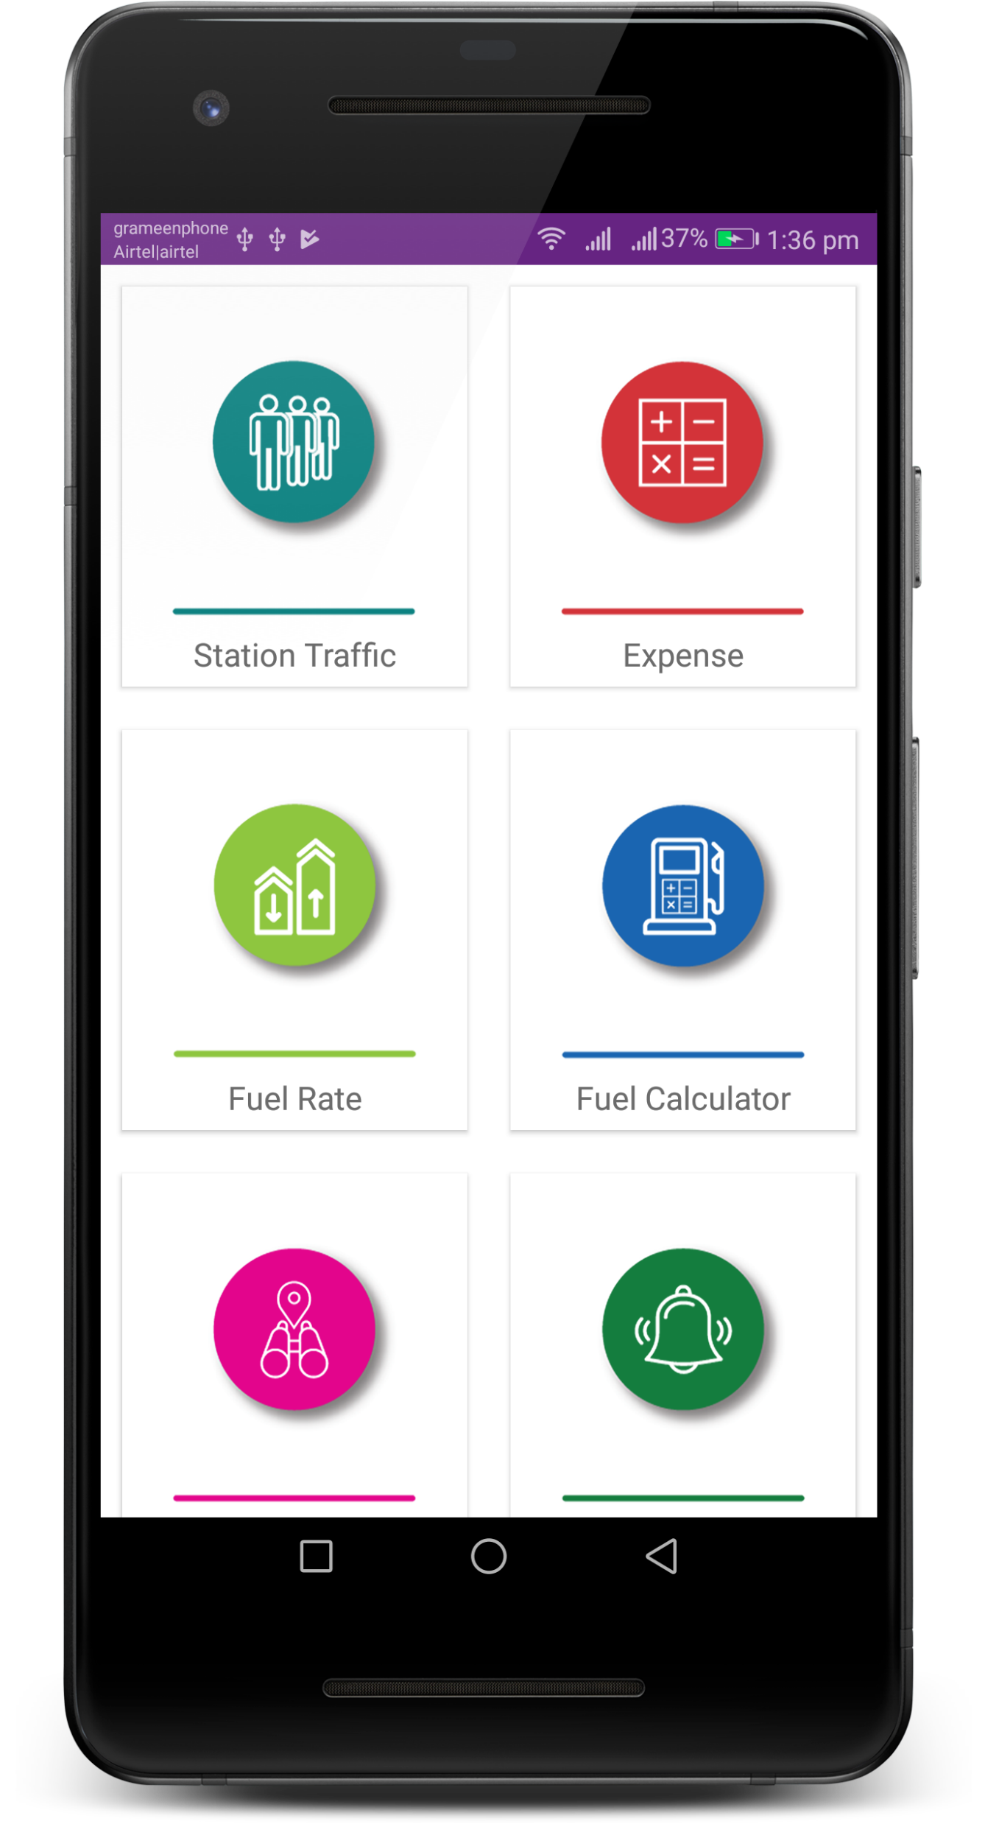
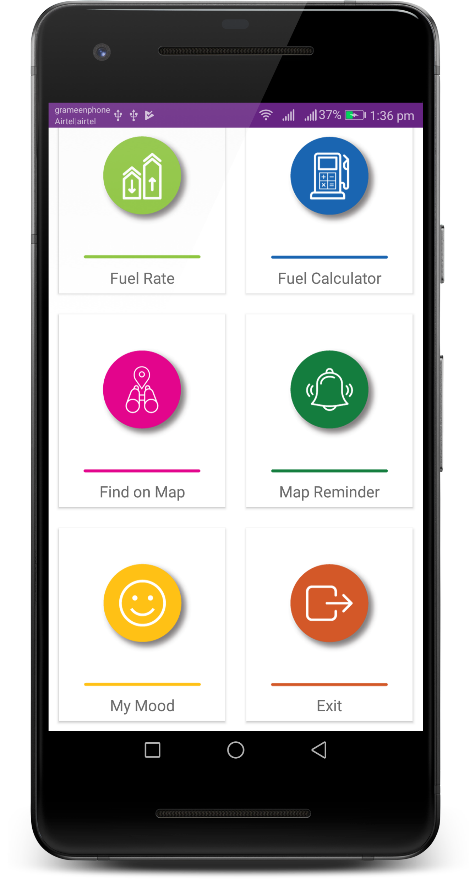
MAIN
DASHBOARD

Slide 11
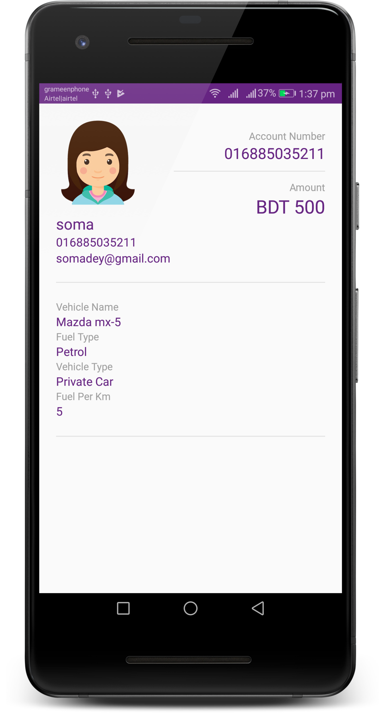

MY
ACCOUNT

Slide 12
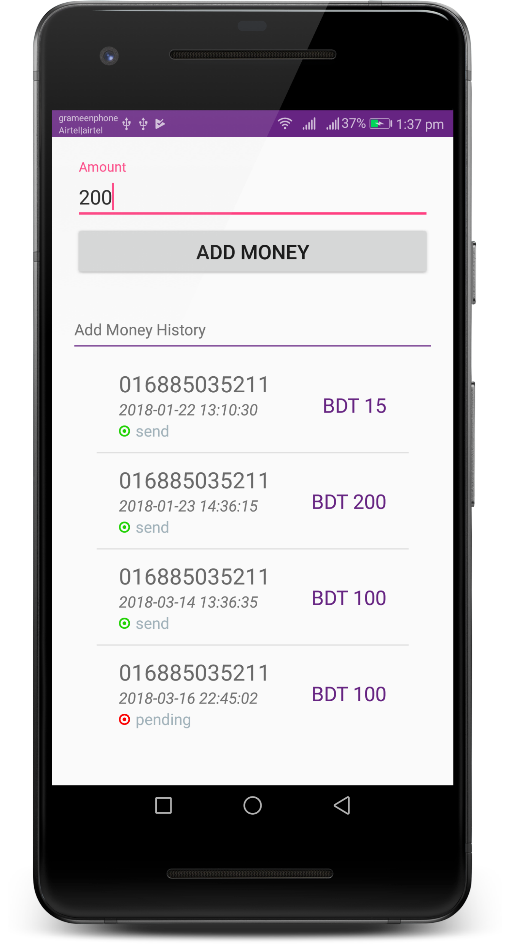

ADD
MONEY

Slide 13
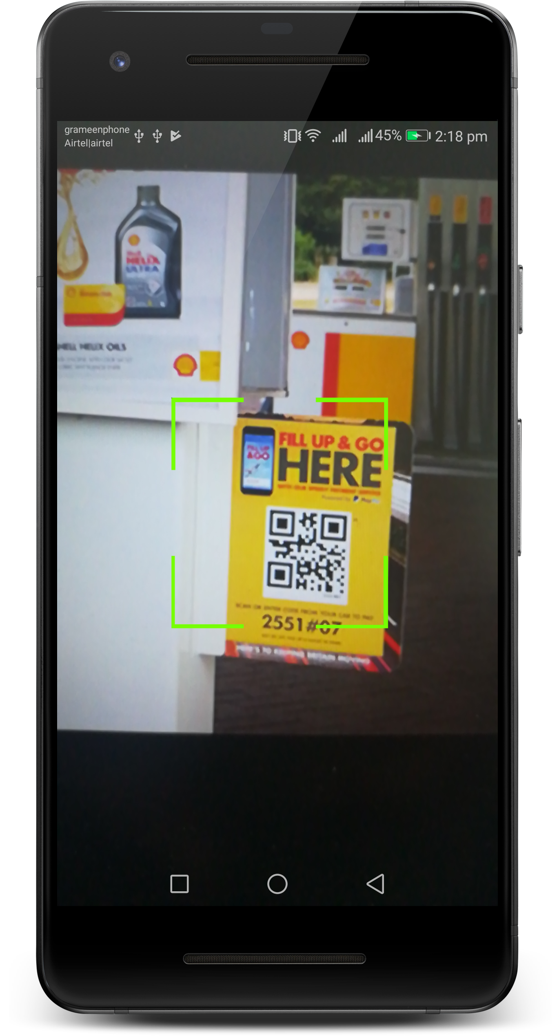
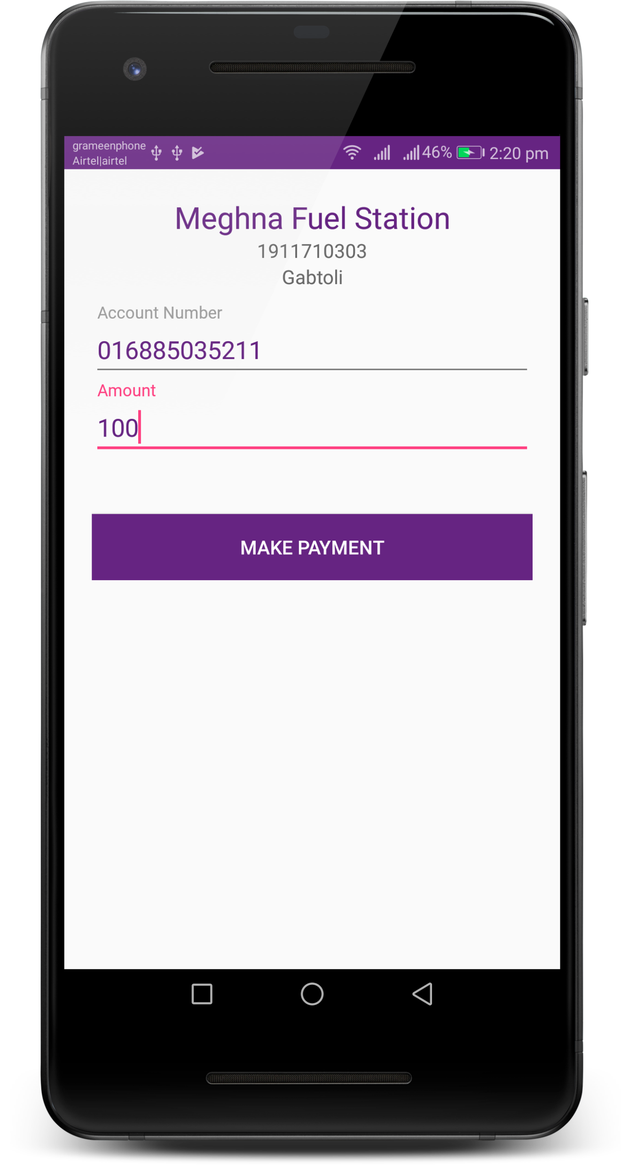
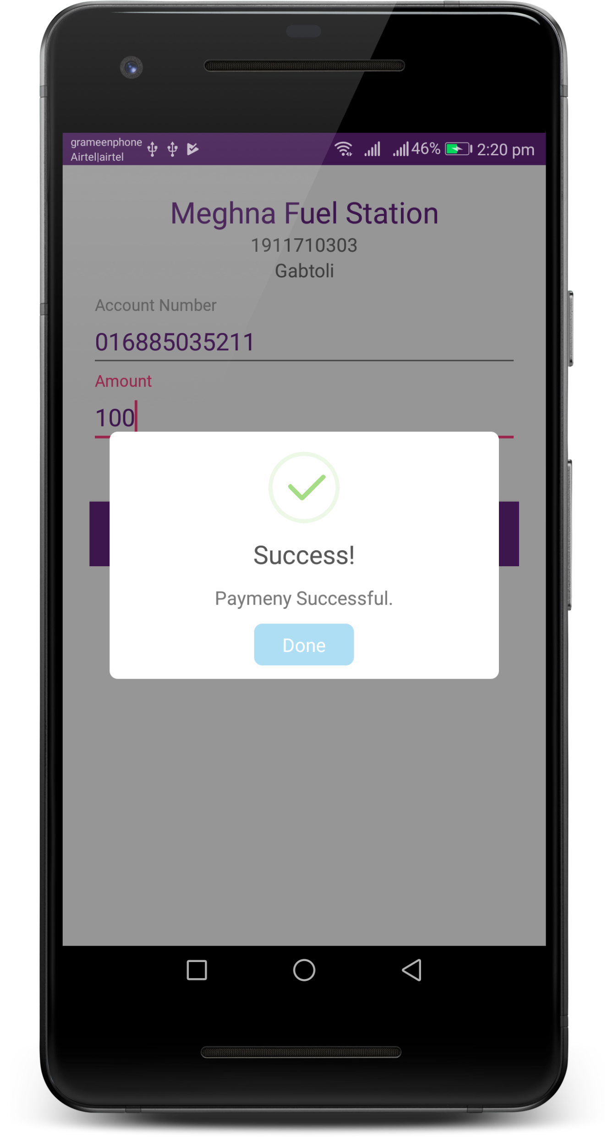
QR
PAYMENT

Slide 14
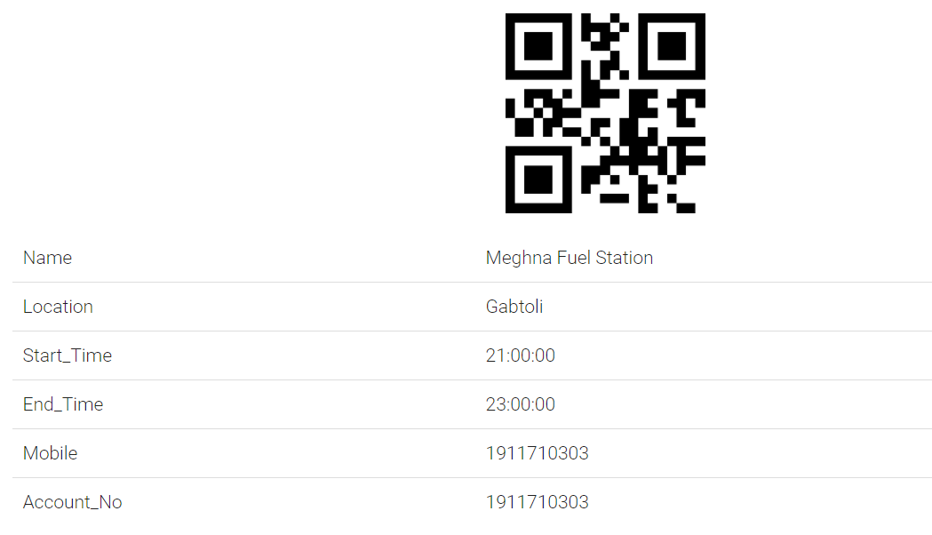
SCAN ME
QR
PAYMENT

Slide 15
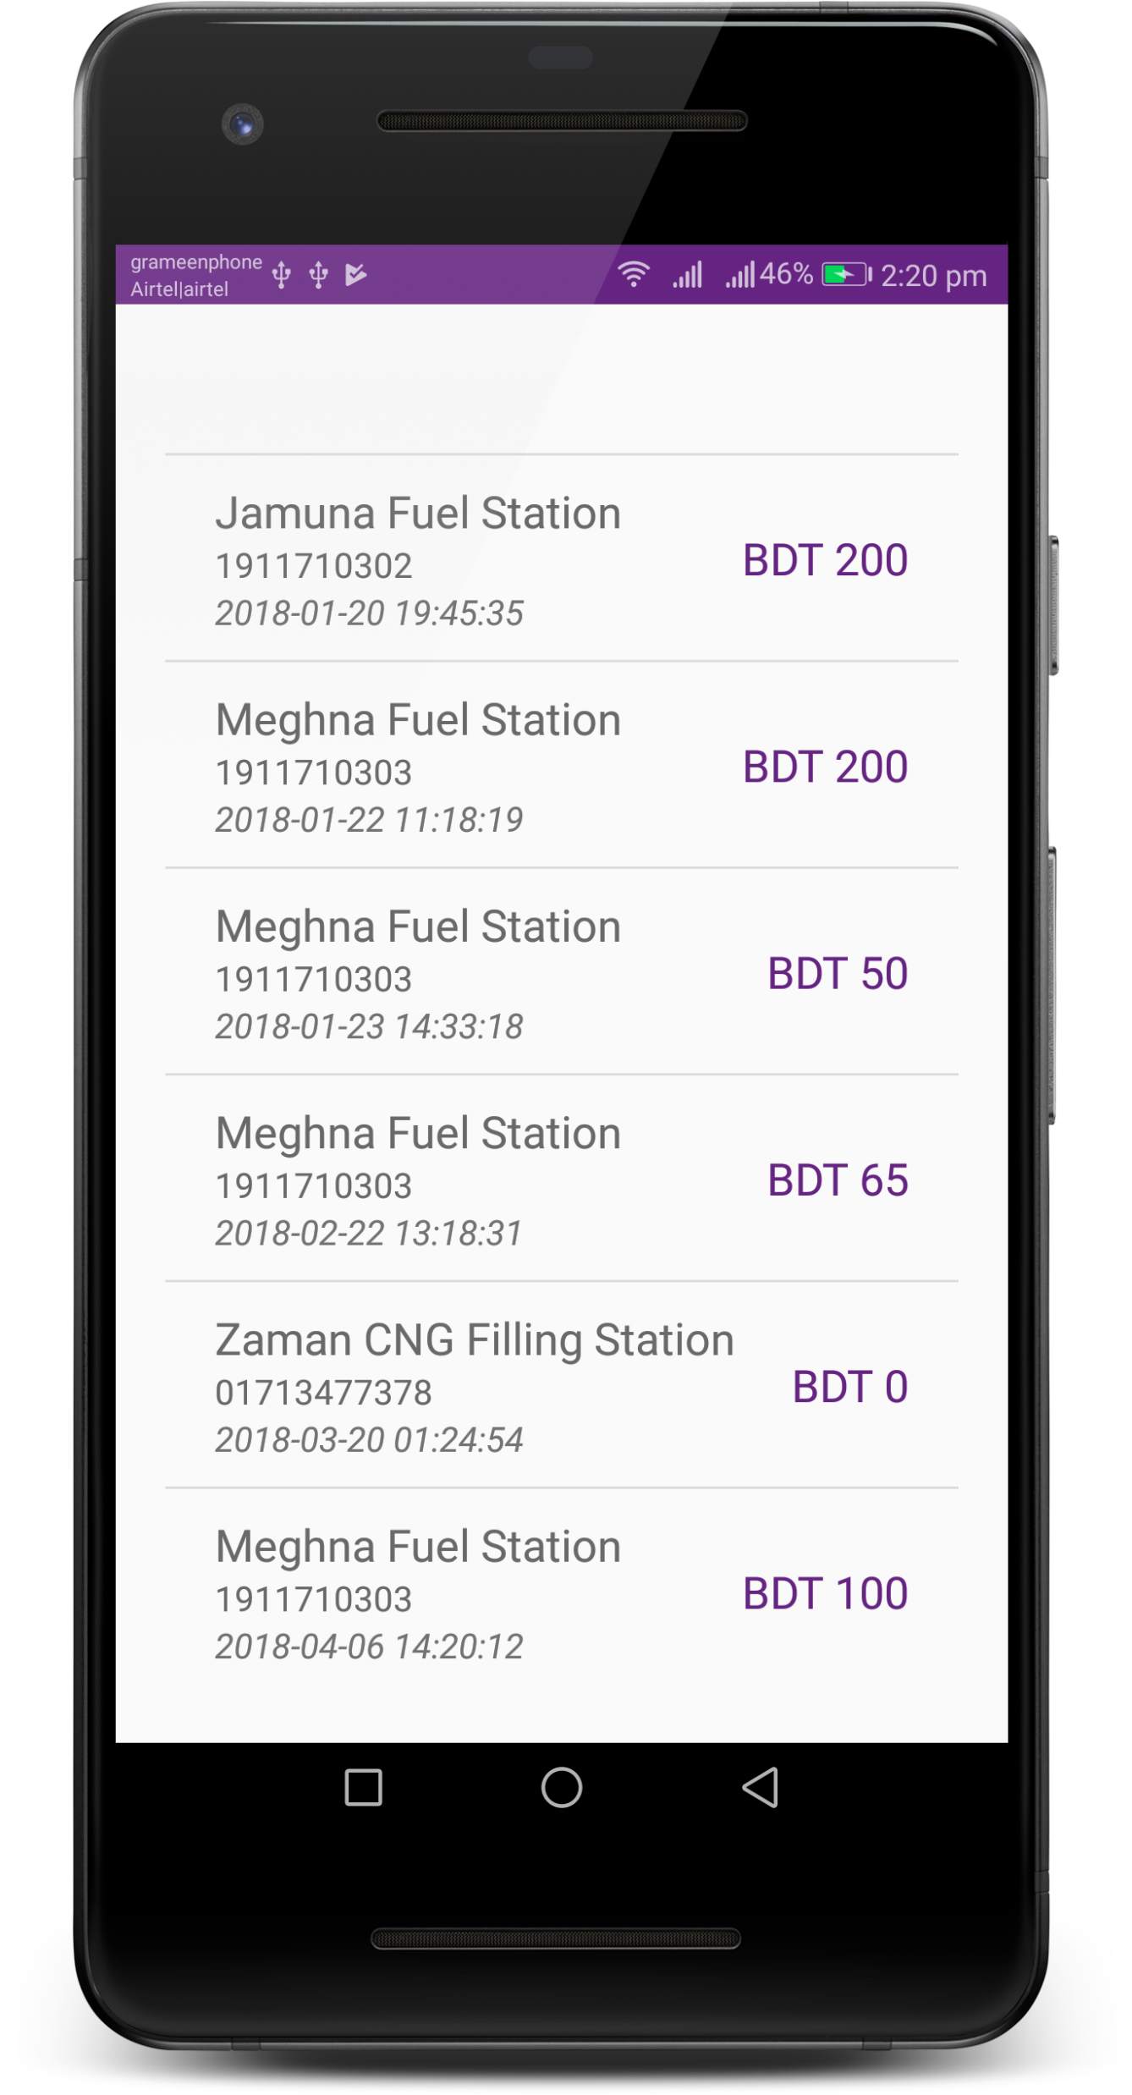

TRANSACTION
HISTORY

Slide 16
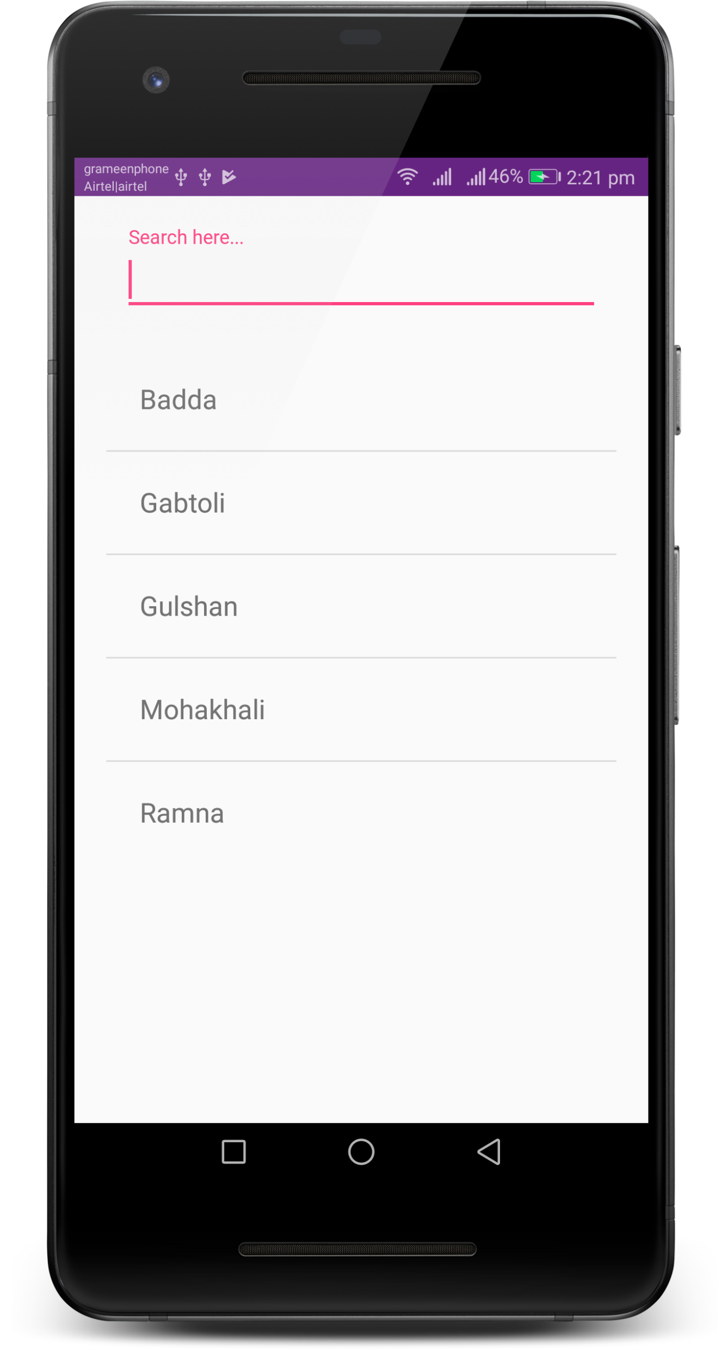
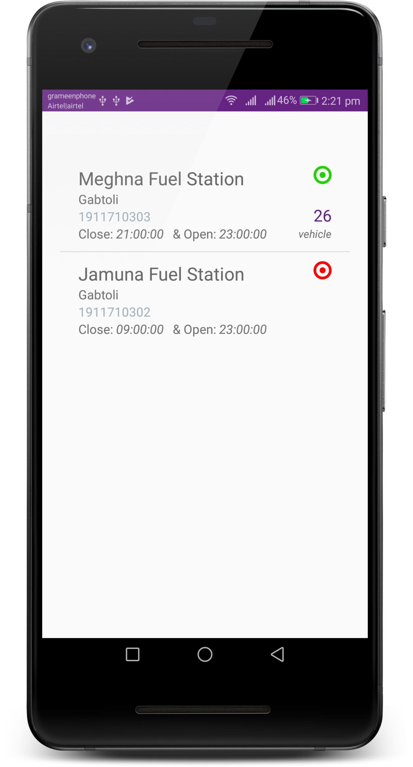
STATION
TRAFFIC

Slide 17
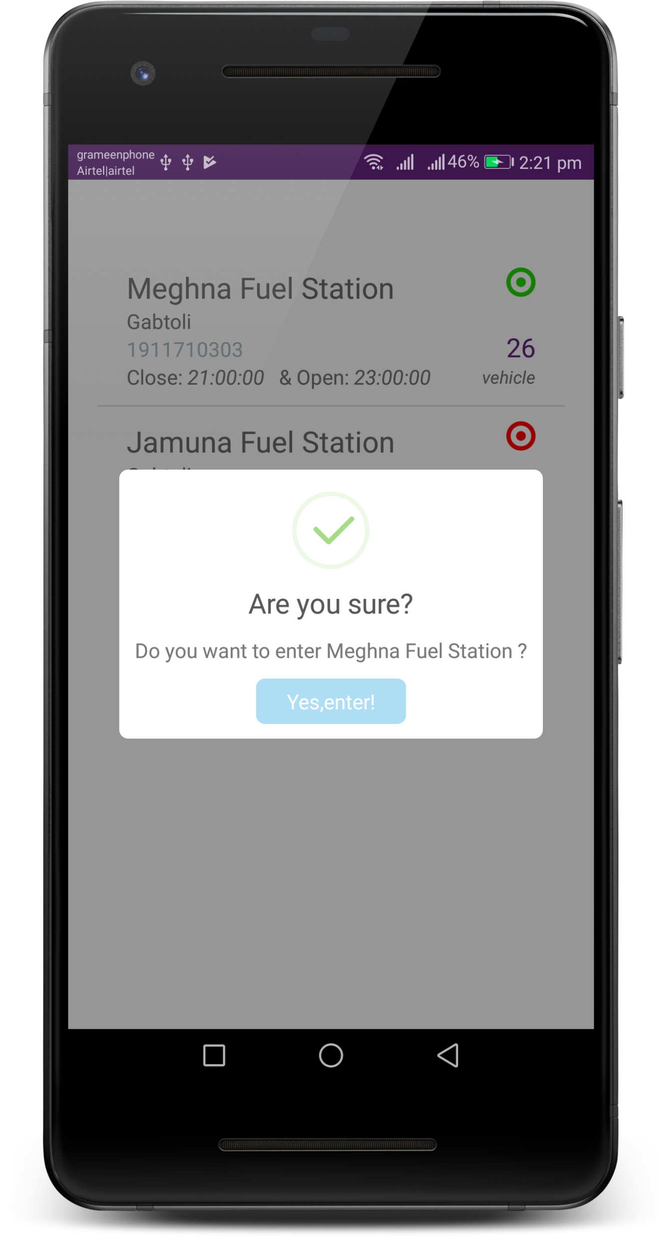
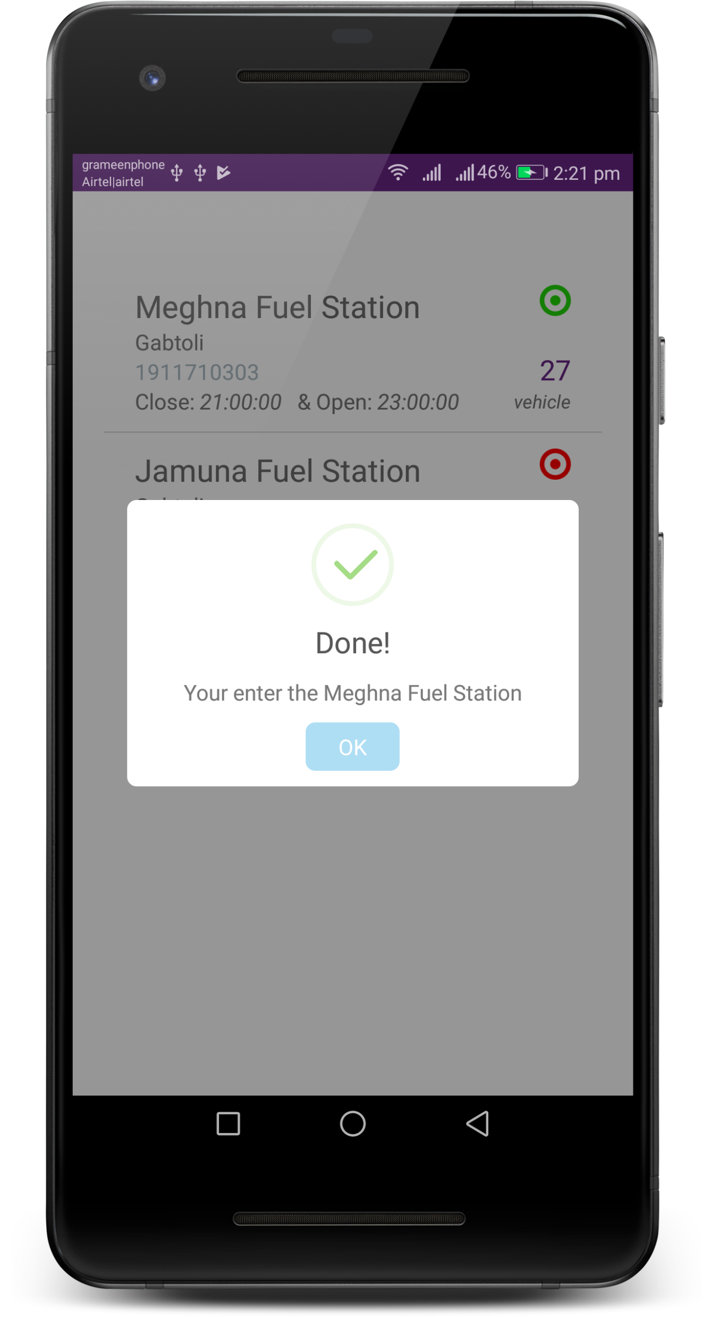
STATION
TRAFFIC

Slide 18
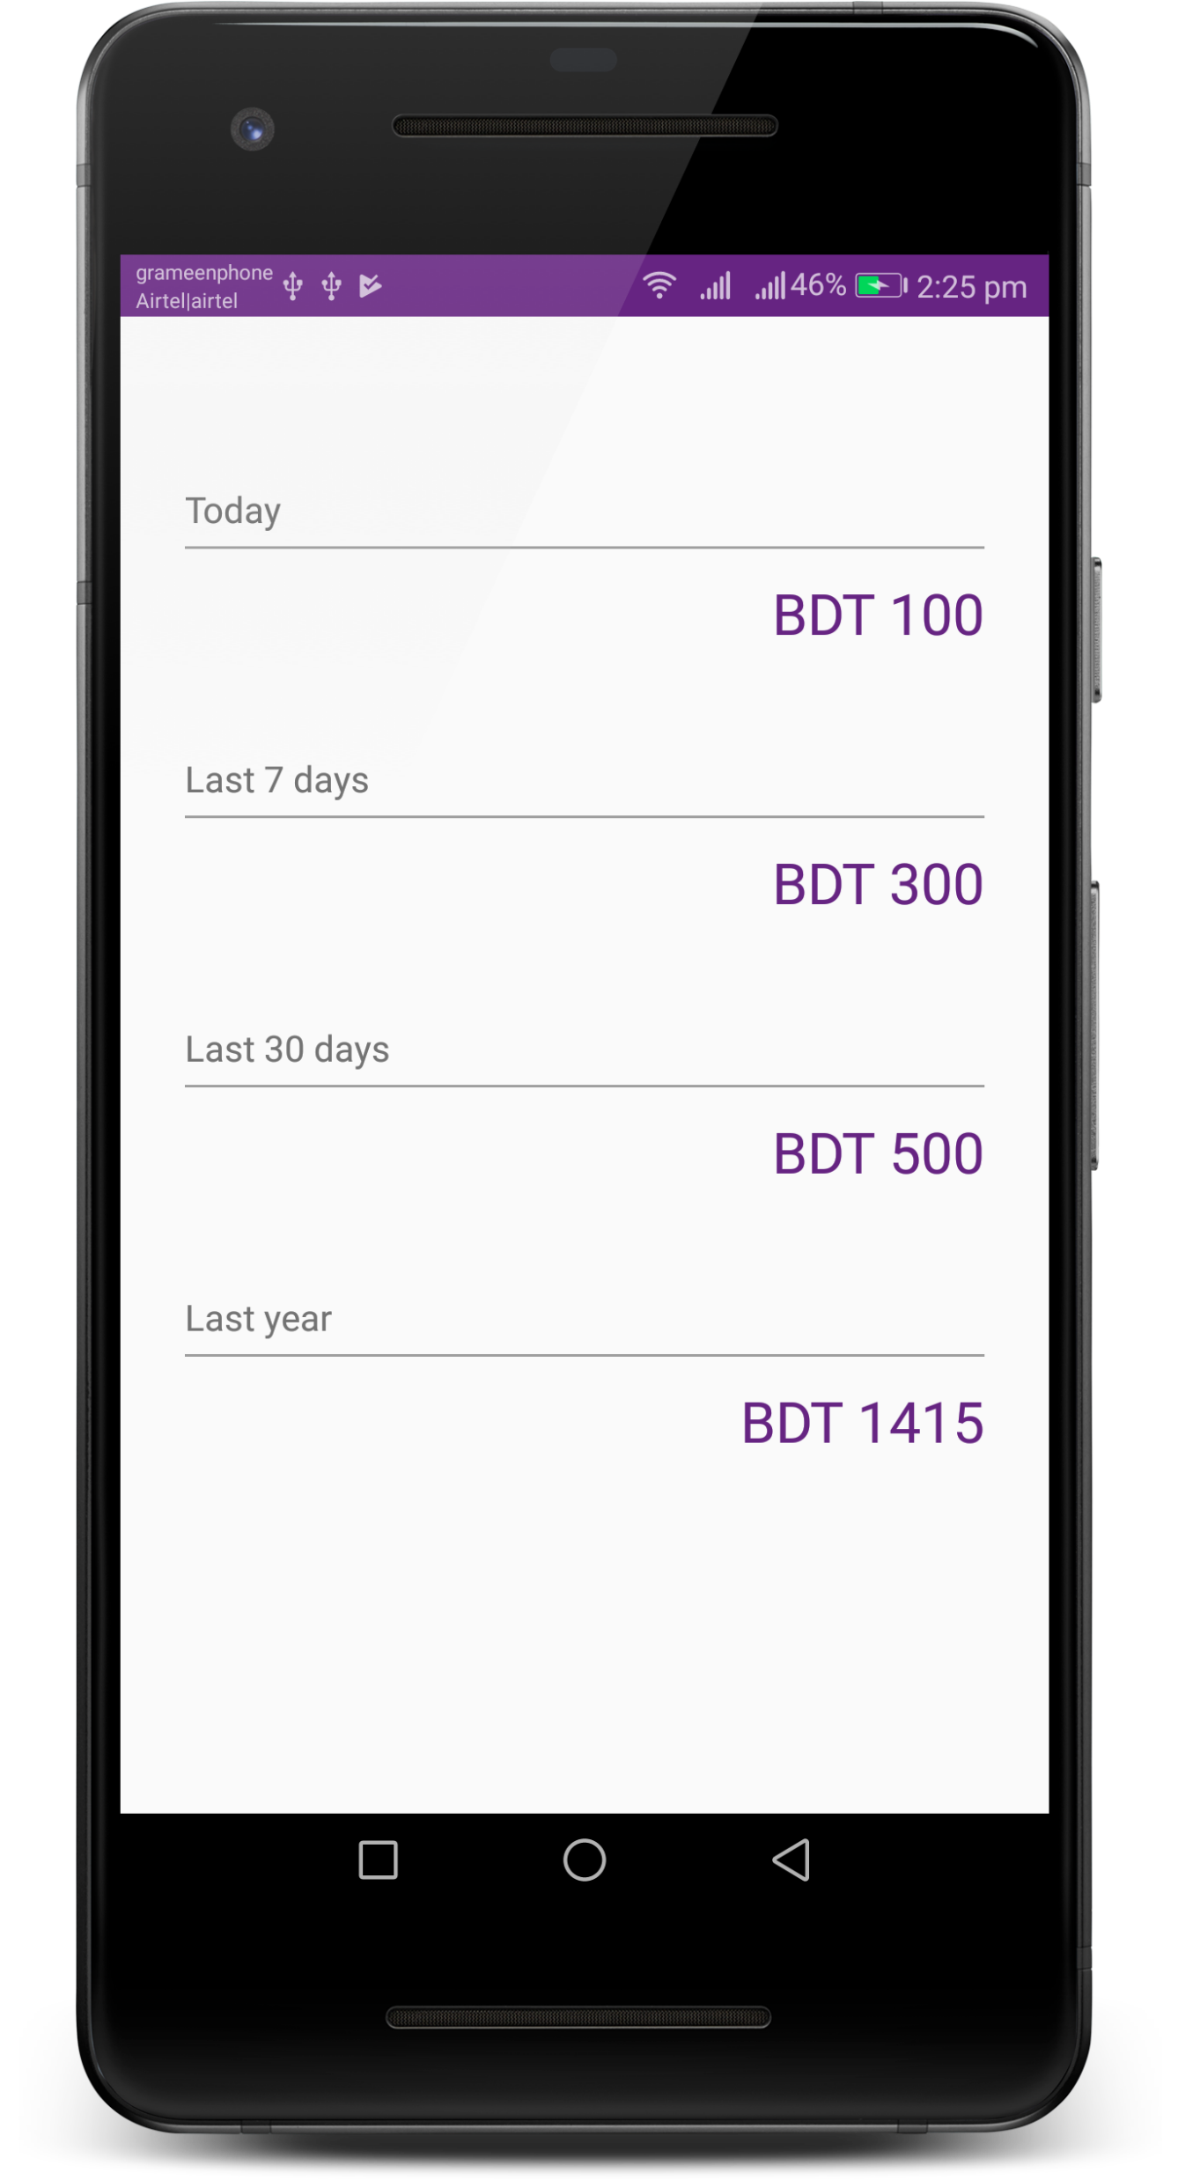
EXPENSE
SUMMARY

Slide 19
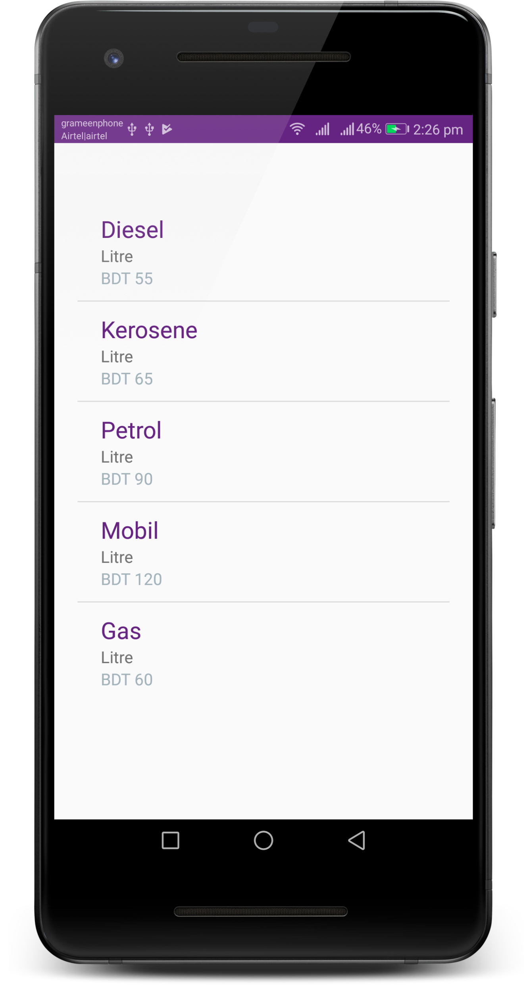
FUEL
RATE

Slide 20
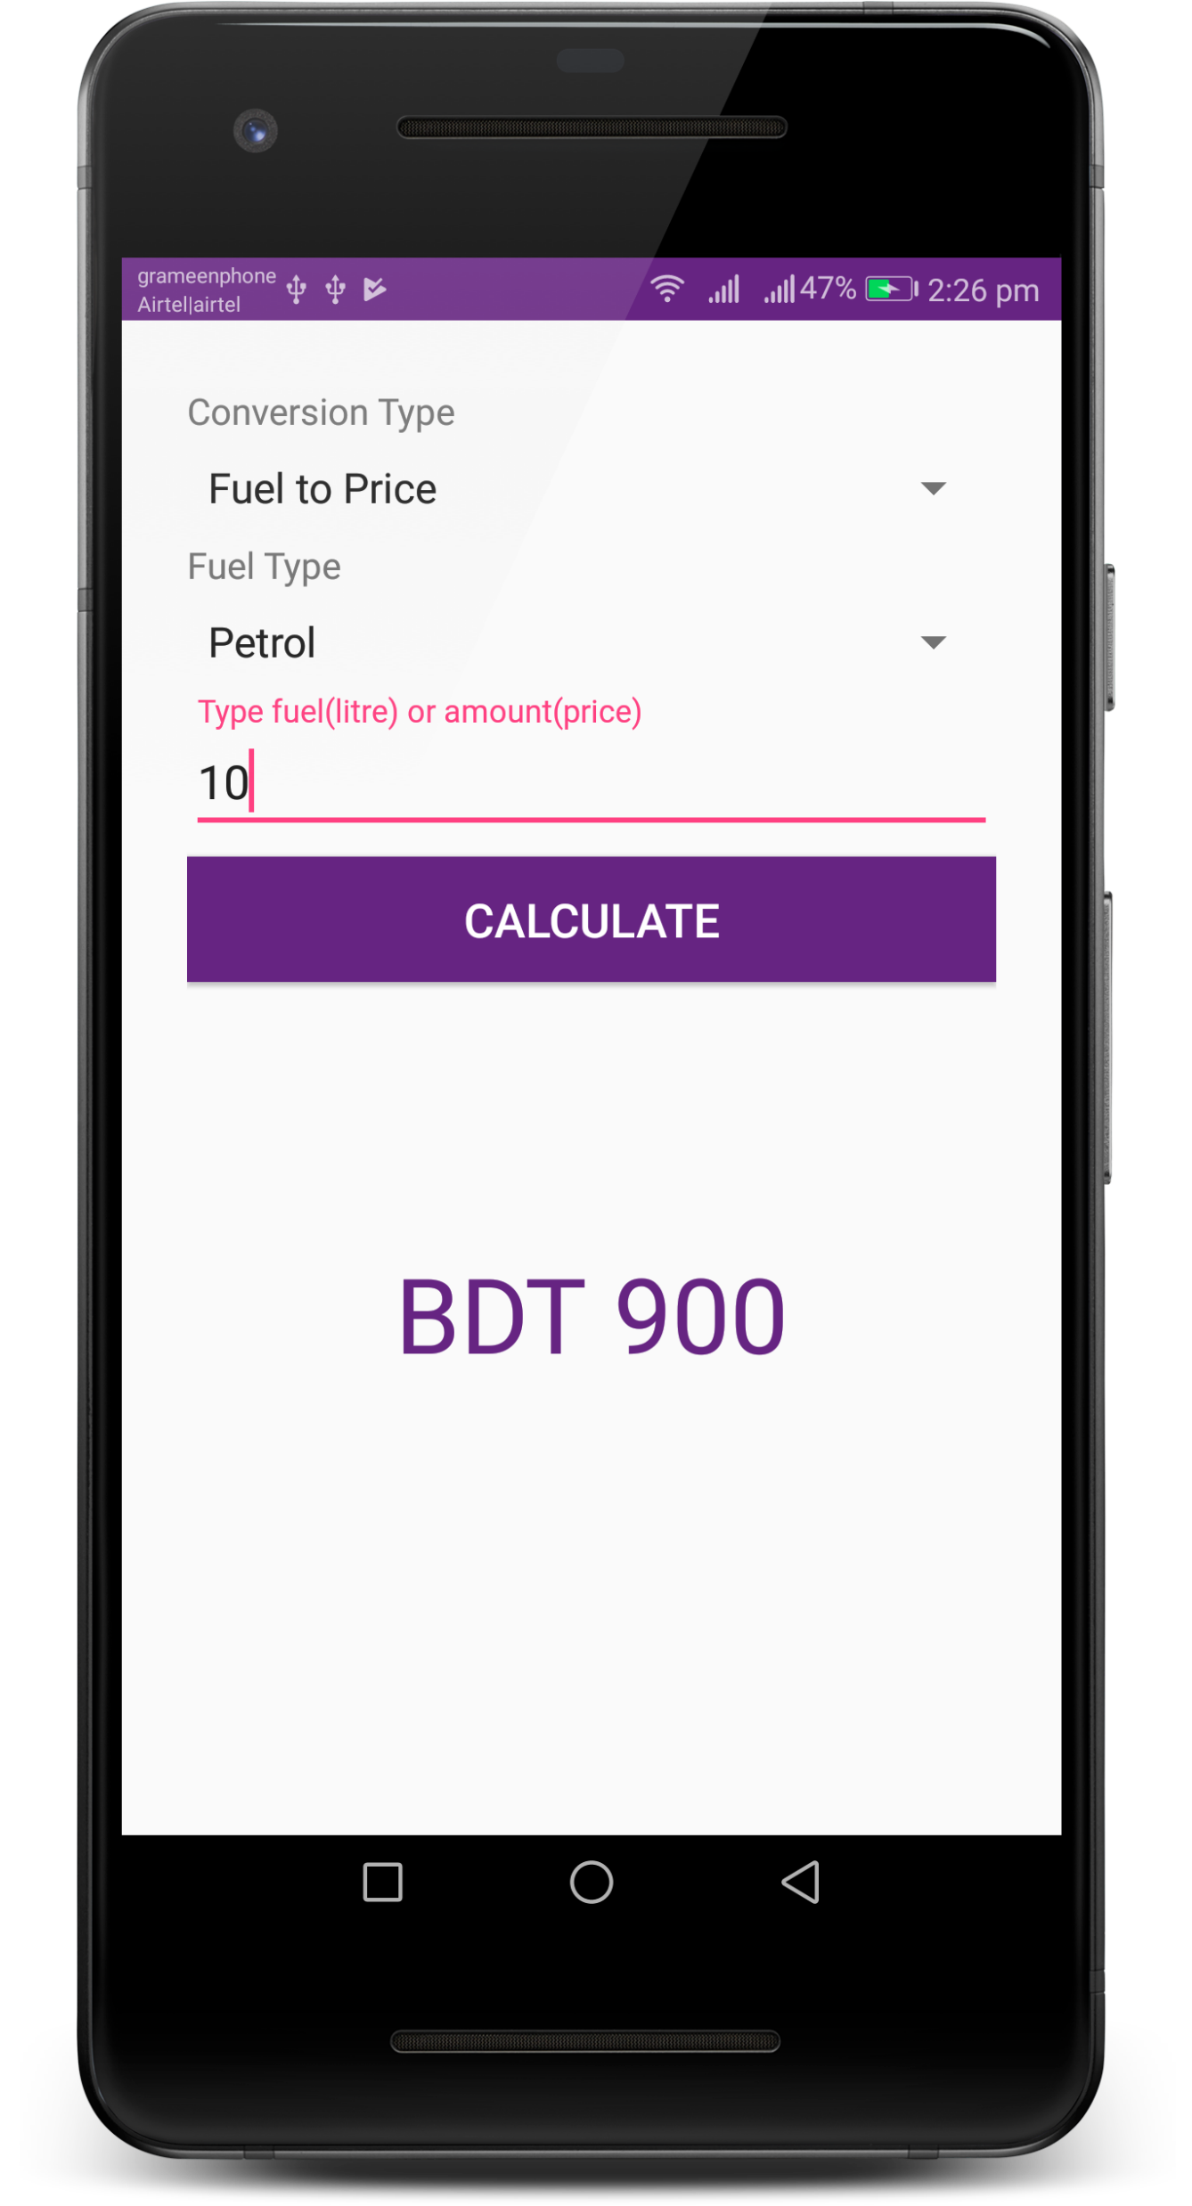
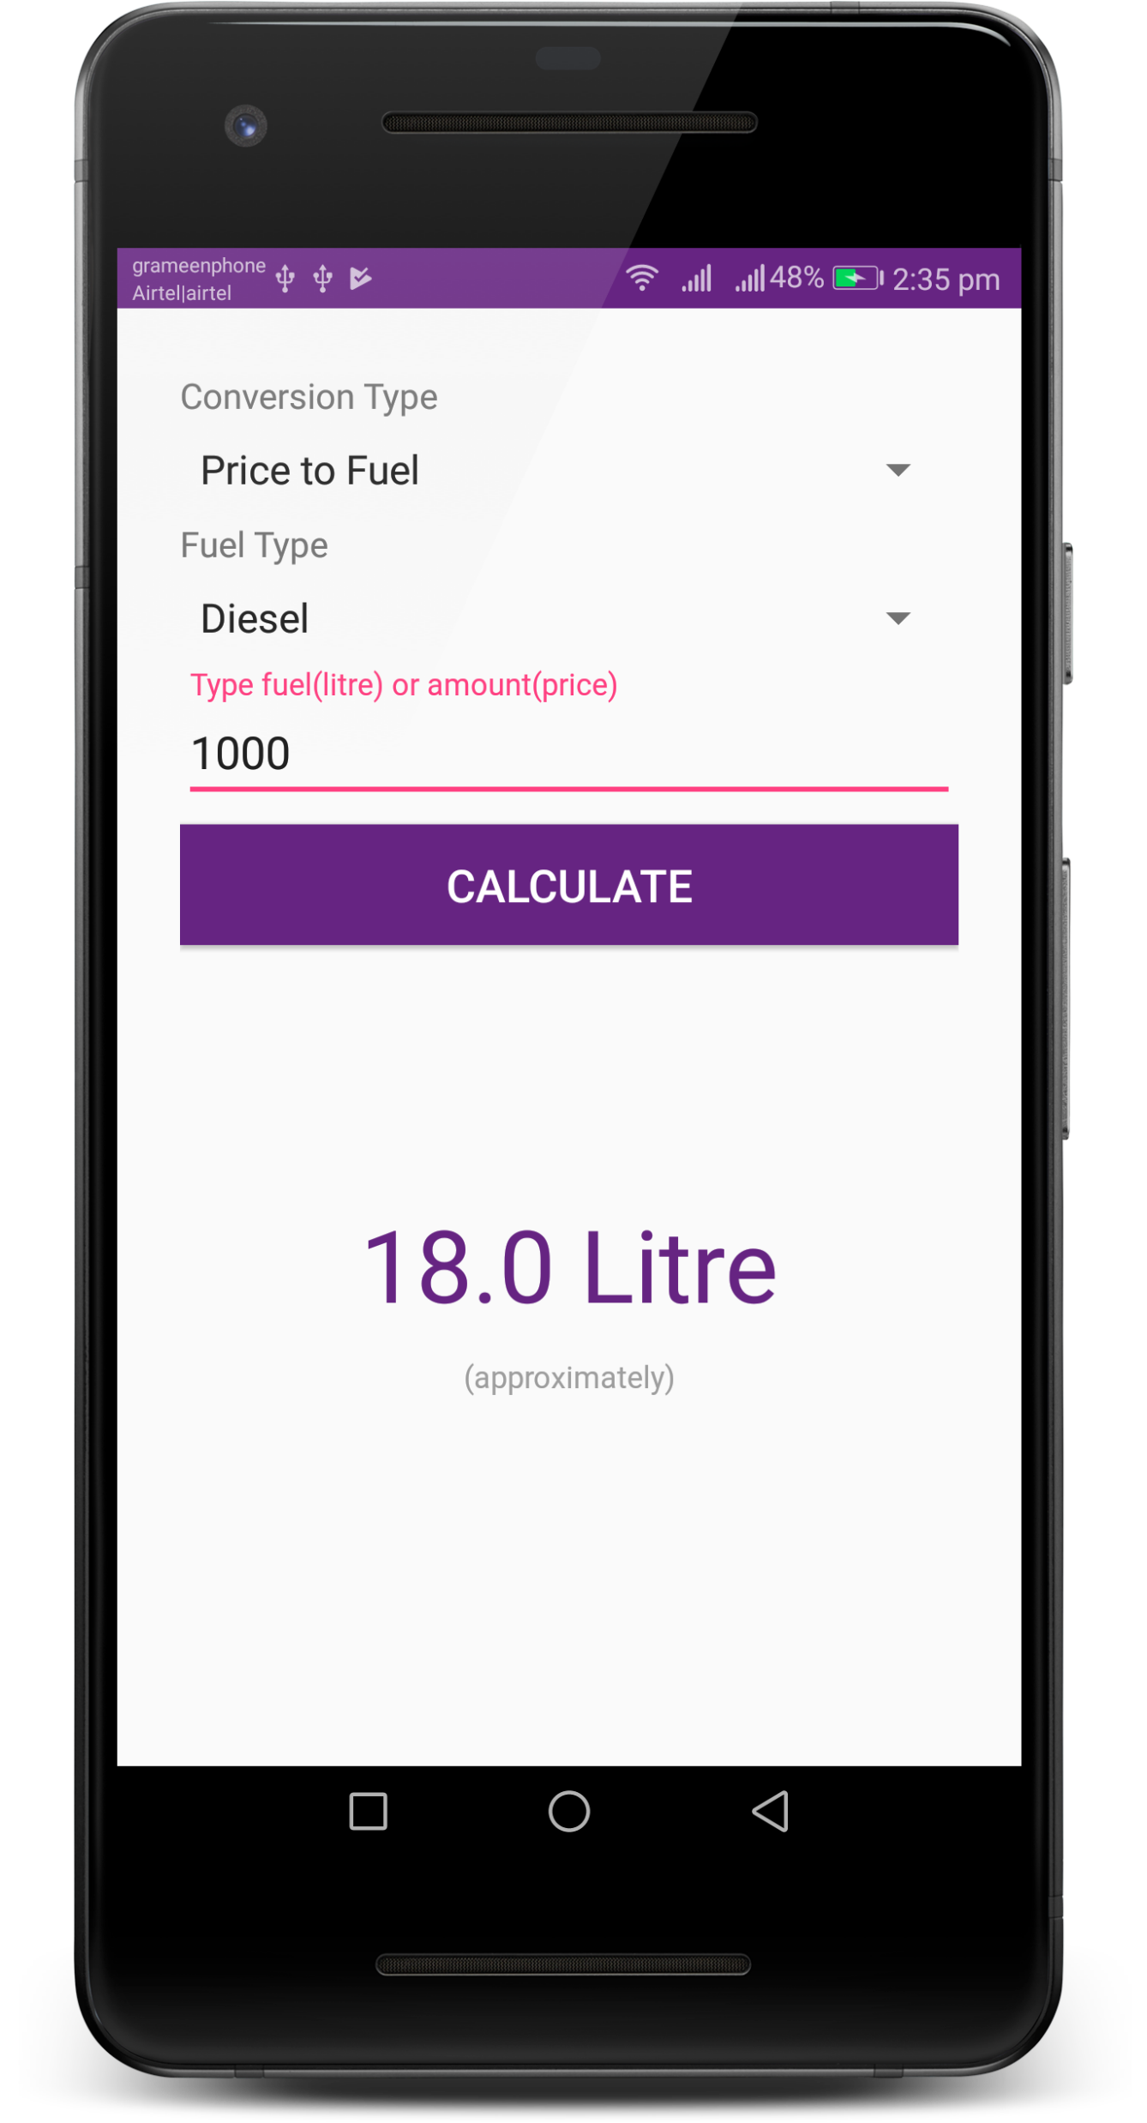
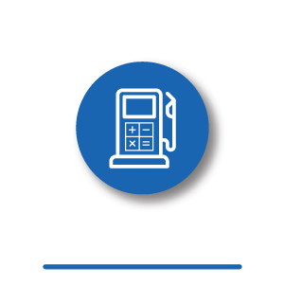
FUEL
CALCULATOR

Slide 21
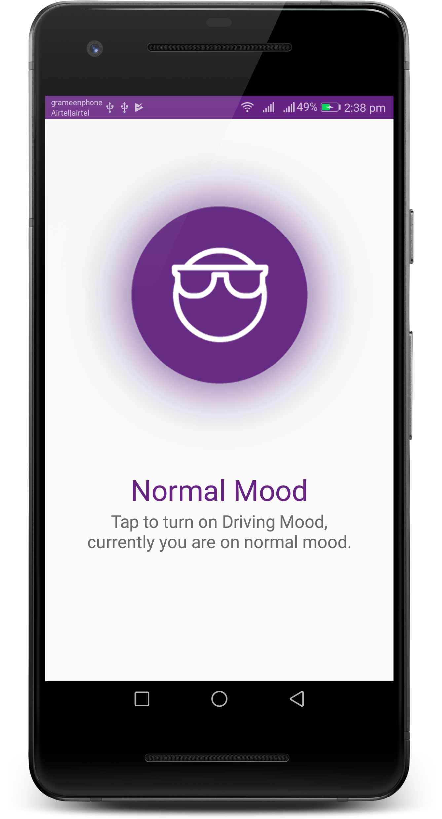
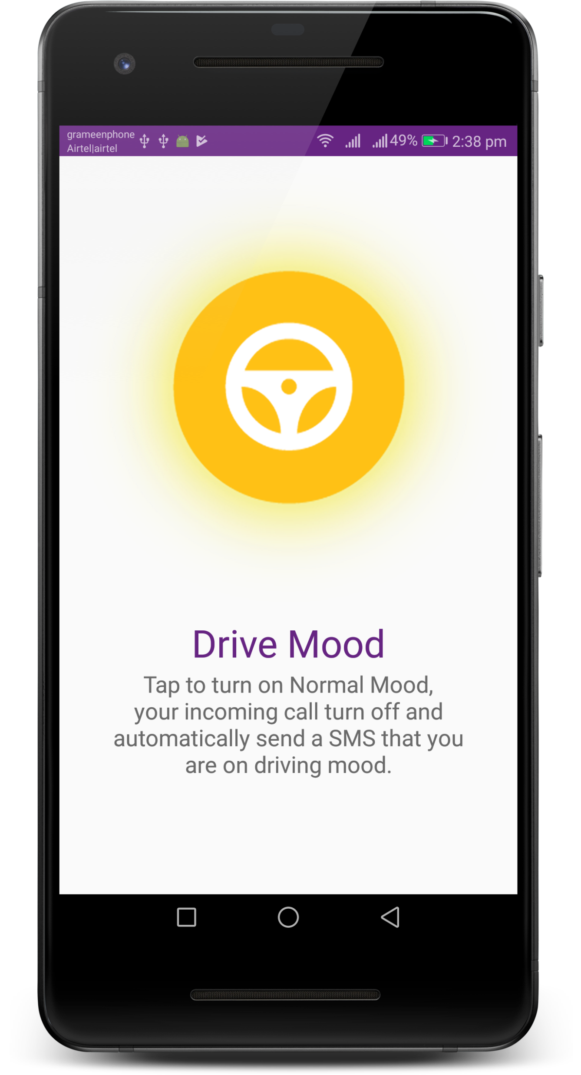
MY
MOOD

Slide 22
Assume User 2 is on Driving Mood
User 1 call to
User 2
User 1
User 2
User 1 get SMS that User 2 is driving now
Driving Mood detect, reject incoming call & send SMS to User 1
DIAGRAM
OF MY MOOD

Slide 23
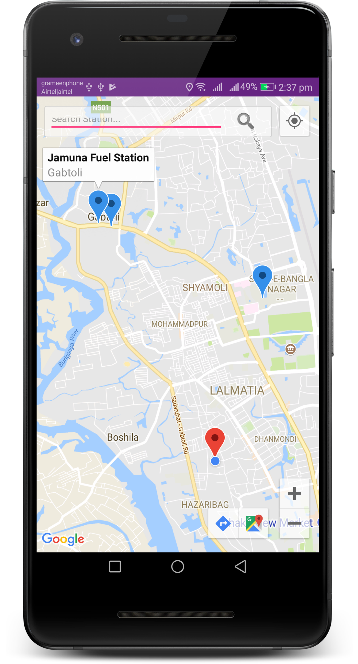
FIND
ON MAP

Slide 24
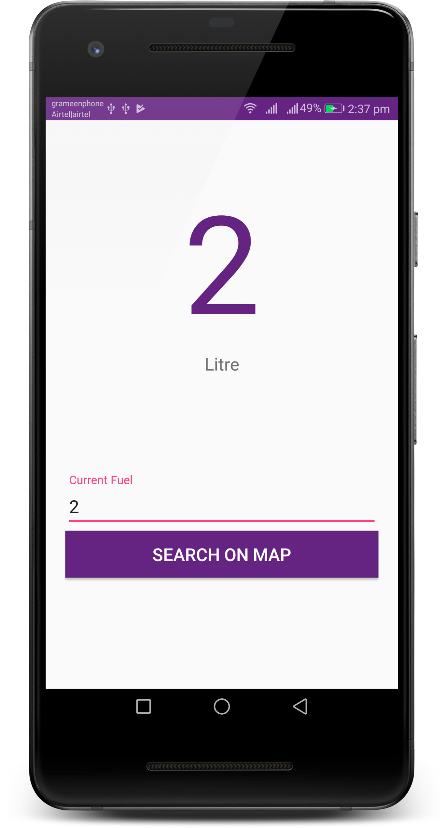
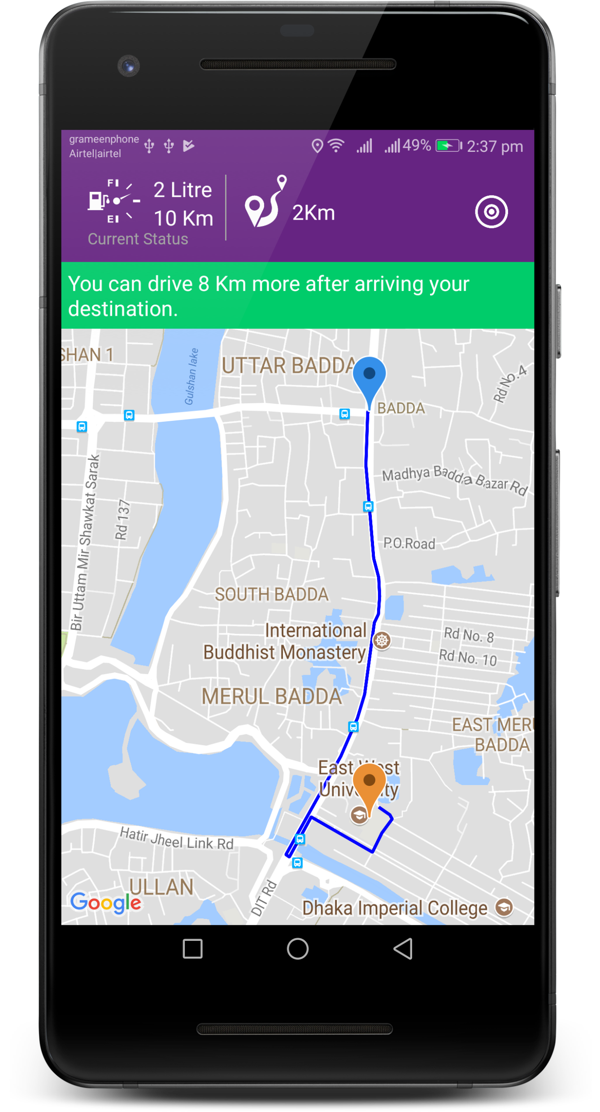
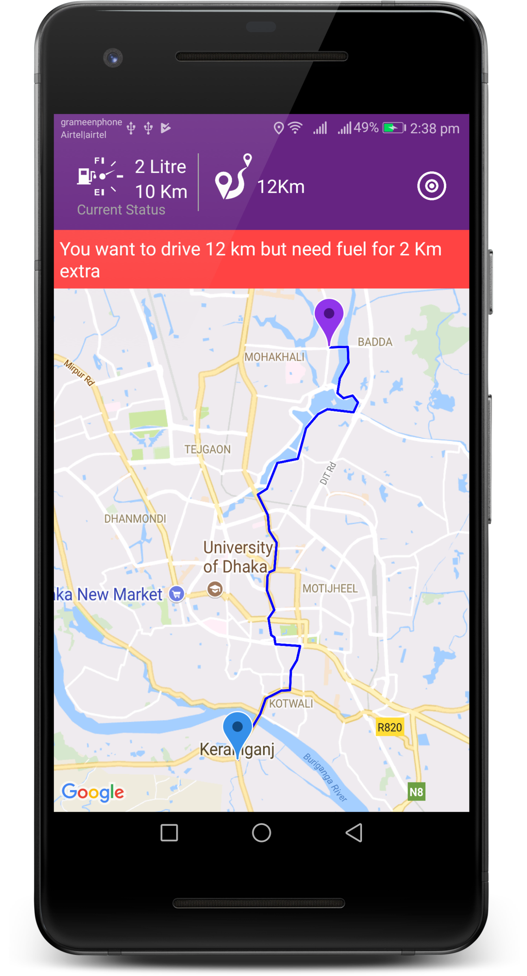

FUEL
REMINDER

Slide 25
THANKS
THE END

